Slide 1

Predicting Employee Attrition
Human Resources Analysis
By: Katrina Zathey, Christian Urday, Justin Kerry

Slide 2

What Exactly Is Attrition?
Staff Attrition is the loss of employees through a natural process without the intention of filling the vacancy left by the former employee.
Not to be confused with Staff Turnover which is the voluntary or involuntary loss of employees with the intention of filling the vacancy left by the former employee.

Slide 3

What Causes Attrition?
Retirement
Resignation
Elimination of a Position
Poor Working Conditions
Lack of Career Growth
Low Pay / No Recognition
Demotivated Employees
Termination of Inefficient Employees
Personal Health
Other Personal Reasons

Slide 4

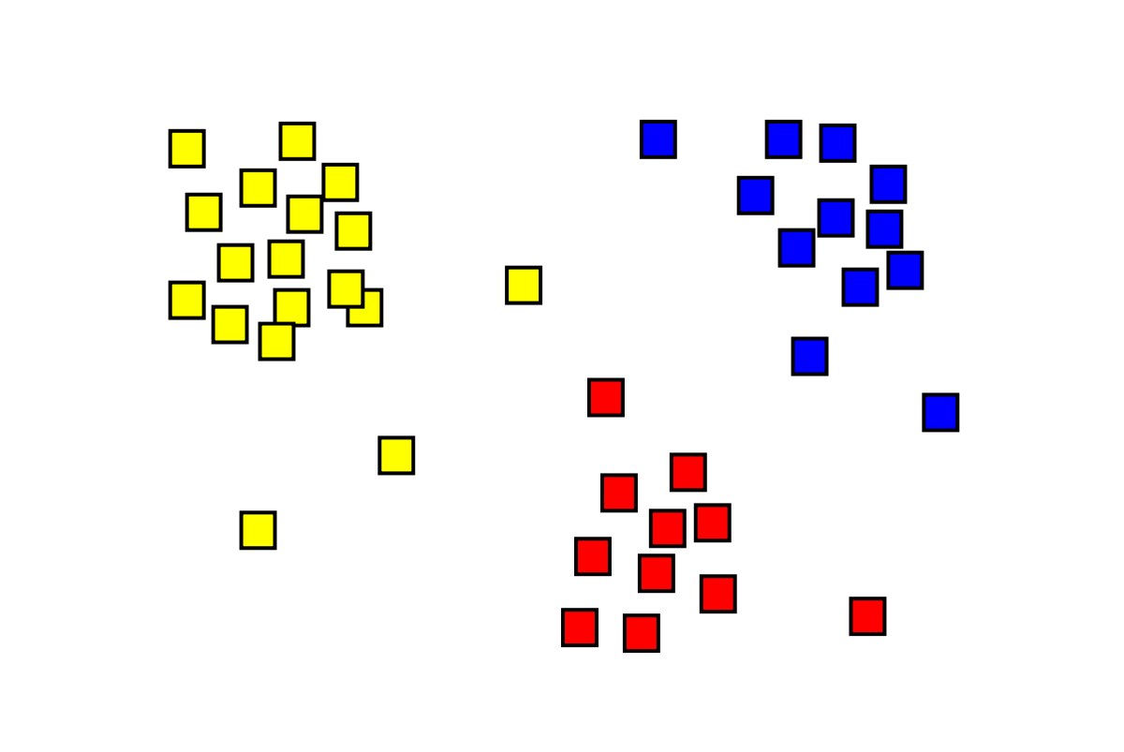
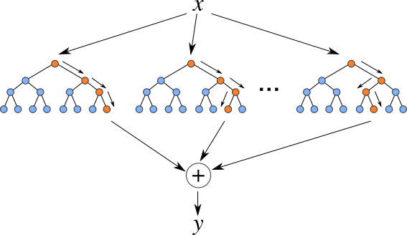
Our Objective
Segmentation of Employees into Clusters
Random Forest Prediction Modeling
Survival Analysis of Clusters

Slide 5

General Approach
Identifying Clusters – K-Means
Prediction Model – Random Forest
Survival Analysis – Kaplan Meier & Cox Proportional Hazard

Slide 6

General Approach
Identifying Clusters – K-Means
Prediction Model – Random Forest
Survival Analysis – Kaplan Meier & Cox Proportional Hazard

Slide 7
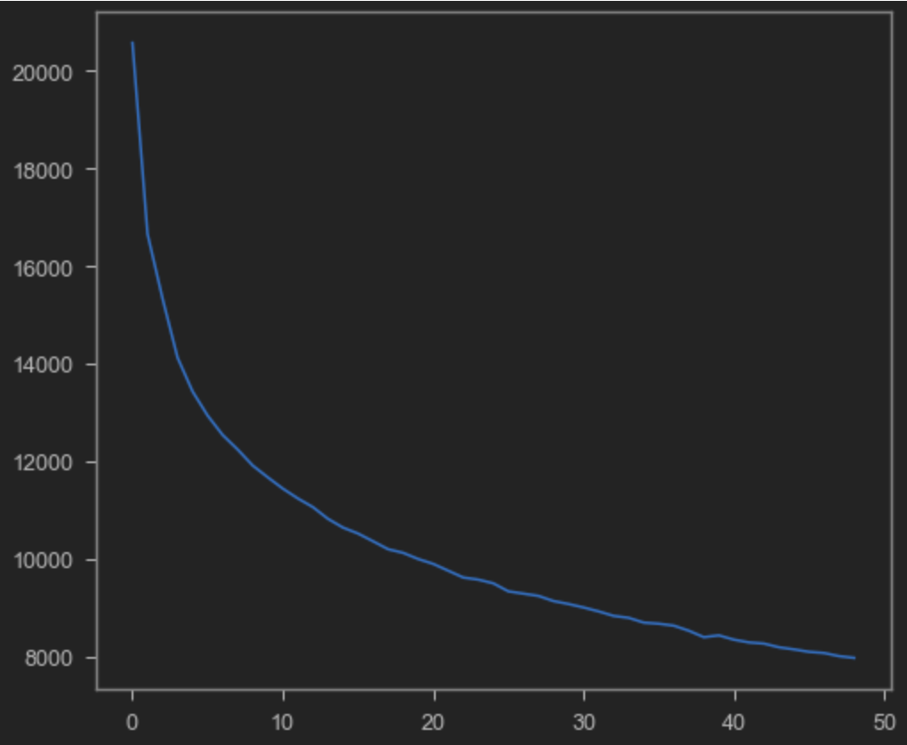
Identifying Clusters – K-Means
We can use the Elbow Method to determine the amount of clusters that the unsupervised K-Means algorithm will generate:

Slide 8
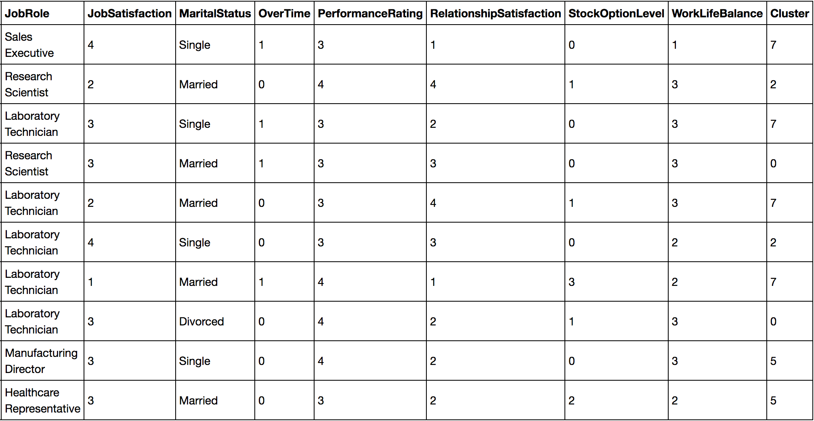
Identifying Clusters – K-Means
After creating our clusters with K-Means, we concatenated the ’Cluster’ column into our dataframe. This can now be visualized in the dataframe shown below:

Slide 9

General Approach
Identifying Clusters – K-Means
Prediction Model – Random Forest
Survival Analysis – Kaplan Meier & Cox Proportional Hazard

Slide 10
Prediction Model – Random Forest
When predicting Attrition:
Attrition_0 = No
Attrition_1 = Yes

Slide 11
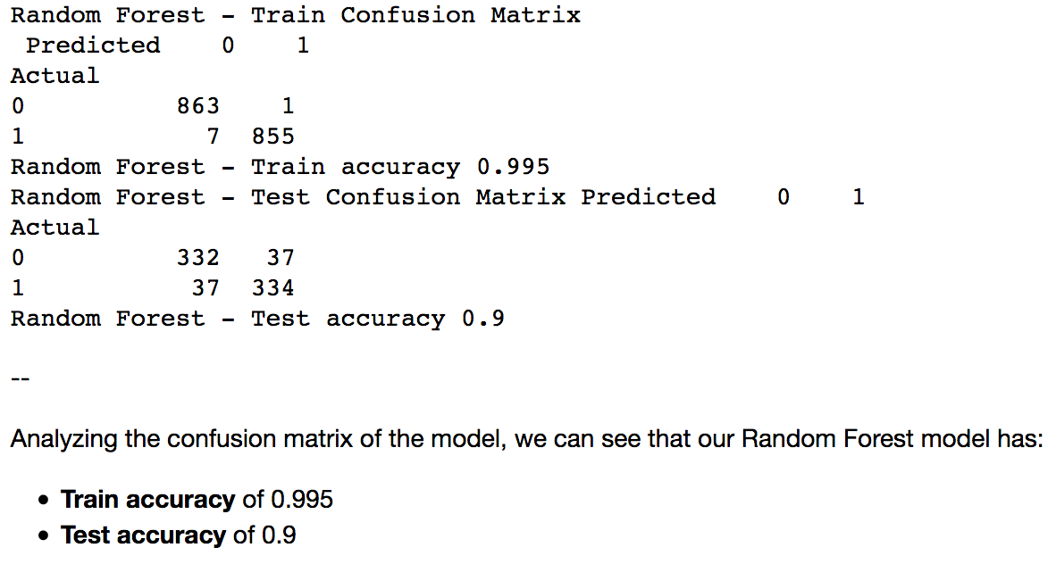
Prediction Model – Random Forest
Using the supervised Random Forest algorithm as our prediction model, we can see the results in the confusion matrix below:

Slide 12
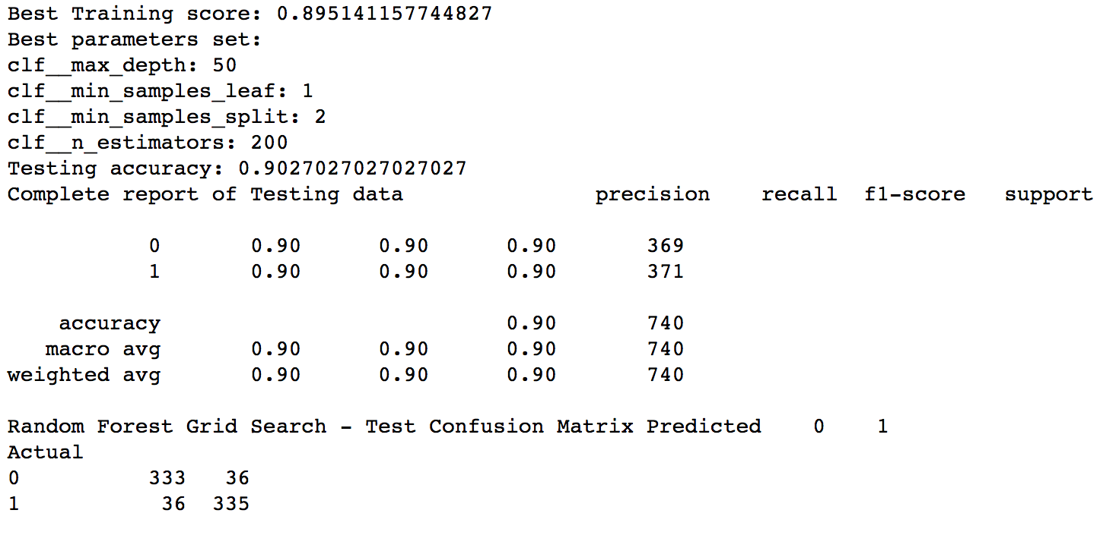
Prediction Model – Random Forest
After applying a Machine Learning Pipeline to our Random Forest model, we can see our Testing Data scores below:

Slide 13

General Approach
Identifying Clusters – K-Means
Prediction Model – Random Forest
Survival Analysis – Kaplan Meier & Cox Proportional Hazard

Slide 14
Survival Analysis – Feature Importance
We used our Random Forest Prediction Model to determine the ranking of the features in regards to their importance. This allowed us to create a dataframe featuring our top 10 features of greatest importance. These are the features that would prove to be the most valuable to the company when considering staff attrition.
We will now show the Feature Importance ranking list on the following slide:

Slide 15
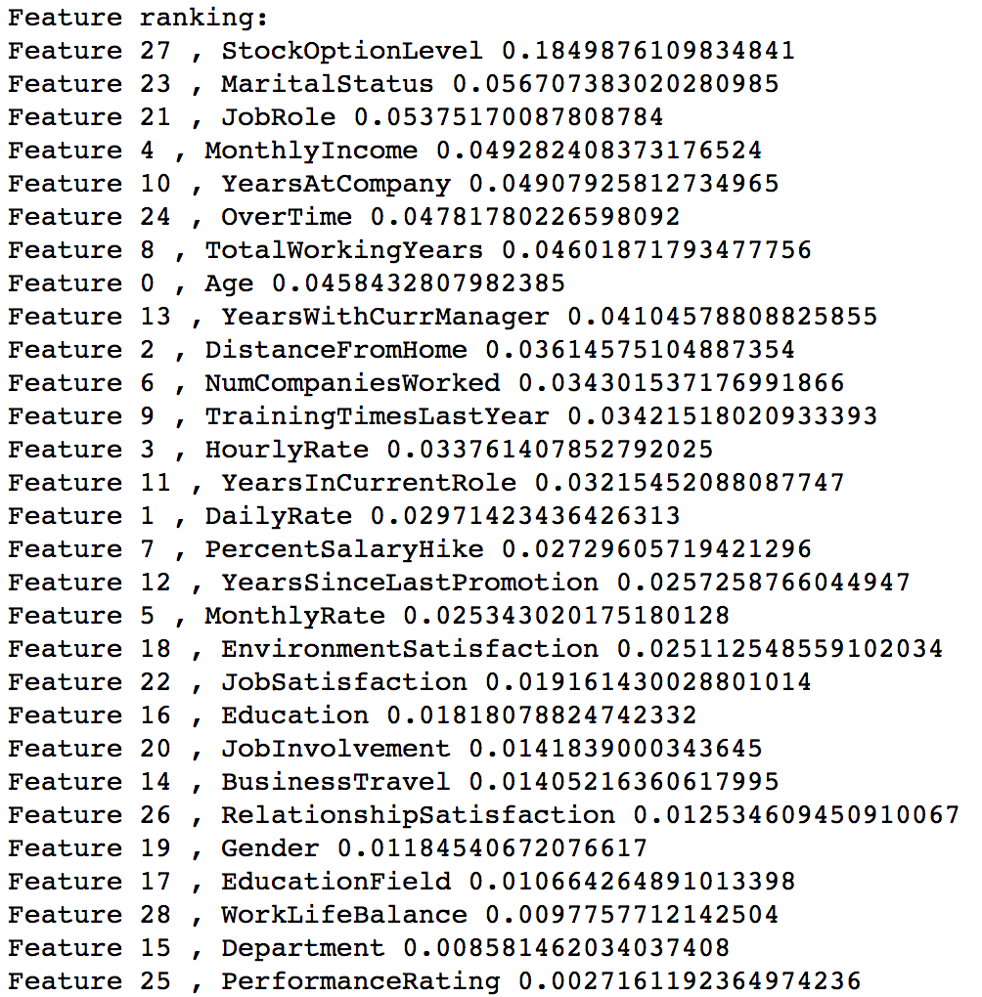
Survival Analysis – Feature Importance

Slide 16

Survival Analysis – Feature Importance
These are the top 10 features that would be the most valuable when analyzing staff attrition:
Stock Option Level
Marital Status
Job Role
Monthly Income
Years At Company
Over Time
Total Working Years
Age
Years With Current Manager
Distance From Home

Slide 17
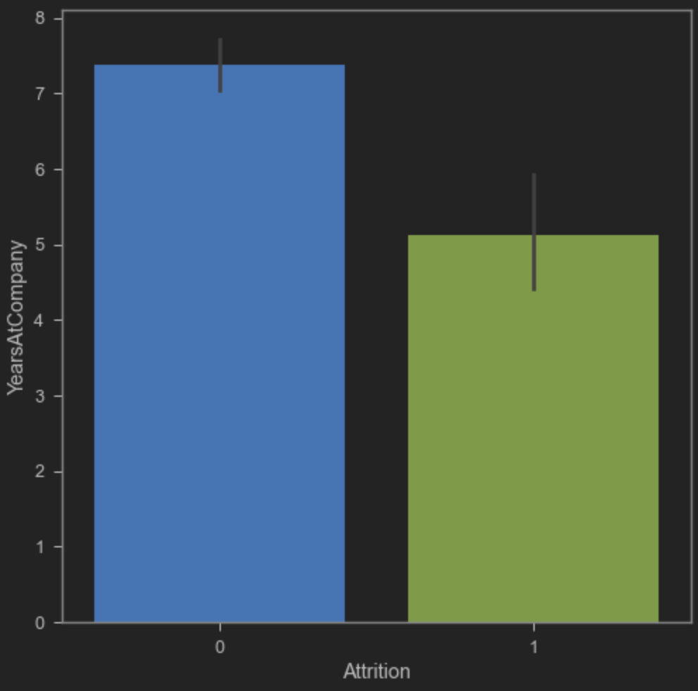
Survival Analysis – Kaplan Meier
In order to run a Kaplan Meier model for survival analysis, we need to define our Duration column and our Event column.
The Duration column will be ‘Years At Company’.
The Event column will be ‘Attrition’.
Remember for Attrition:
0 = No
1 = Yes

Slide 18
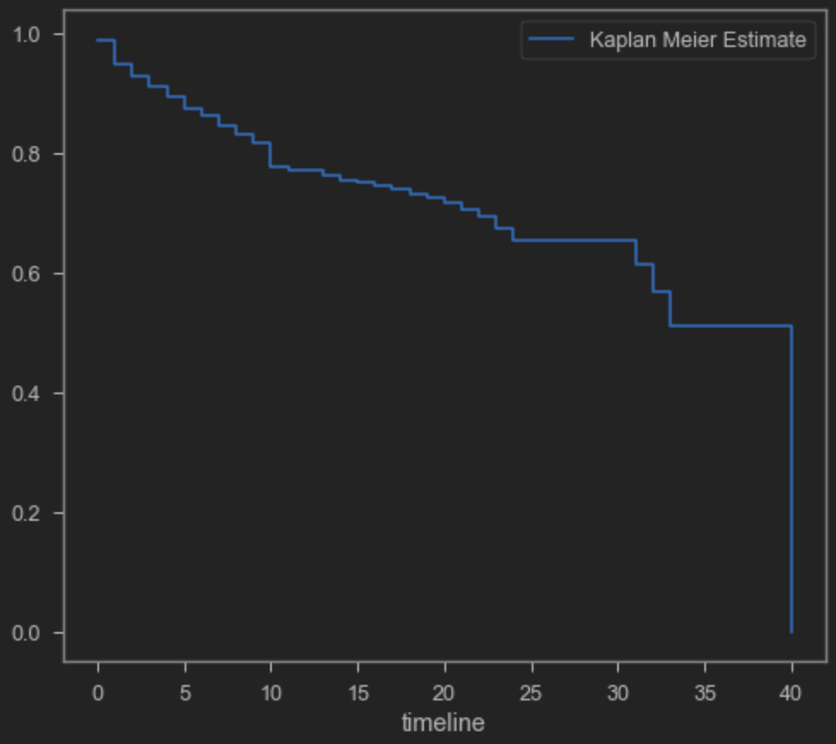
Survival Analysis – Kaplan Meier
The Kaplan Meier Estimator allows us to use observed data to estimate the survival distribution.
The curve in this plot shows us the cumulative probability of survival beyond each given time period represented by years.

Slide 19
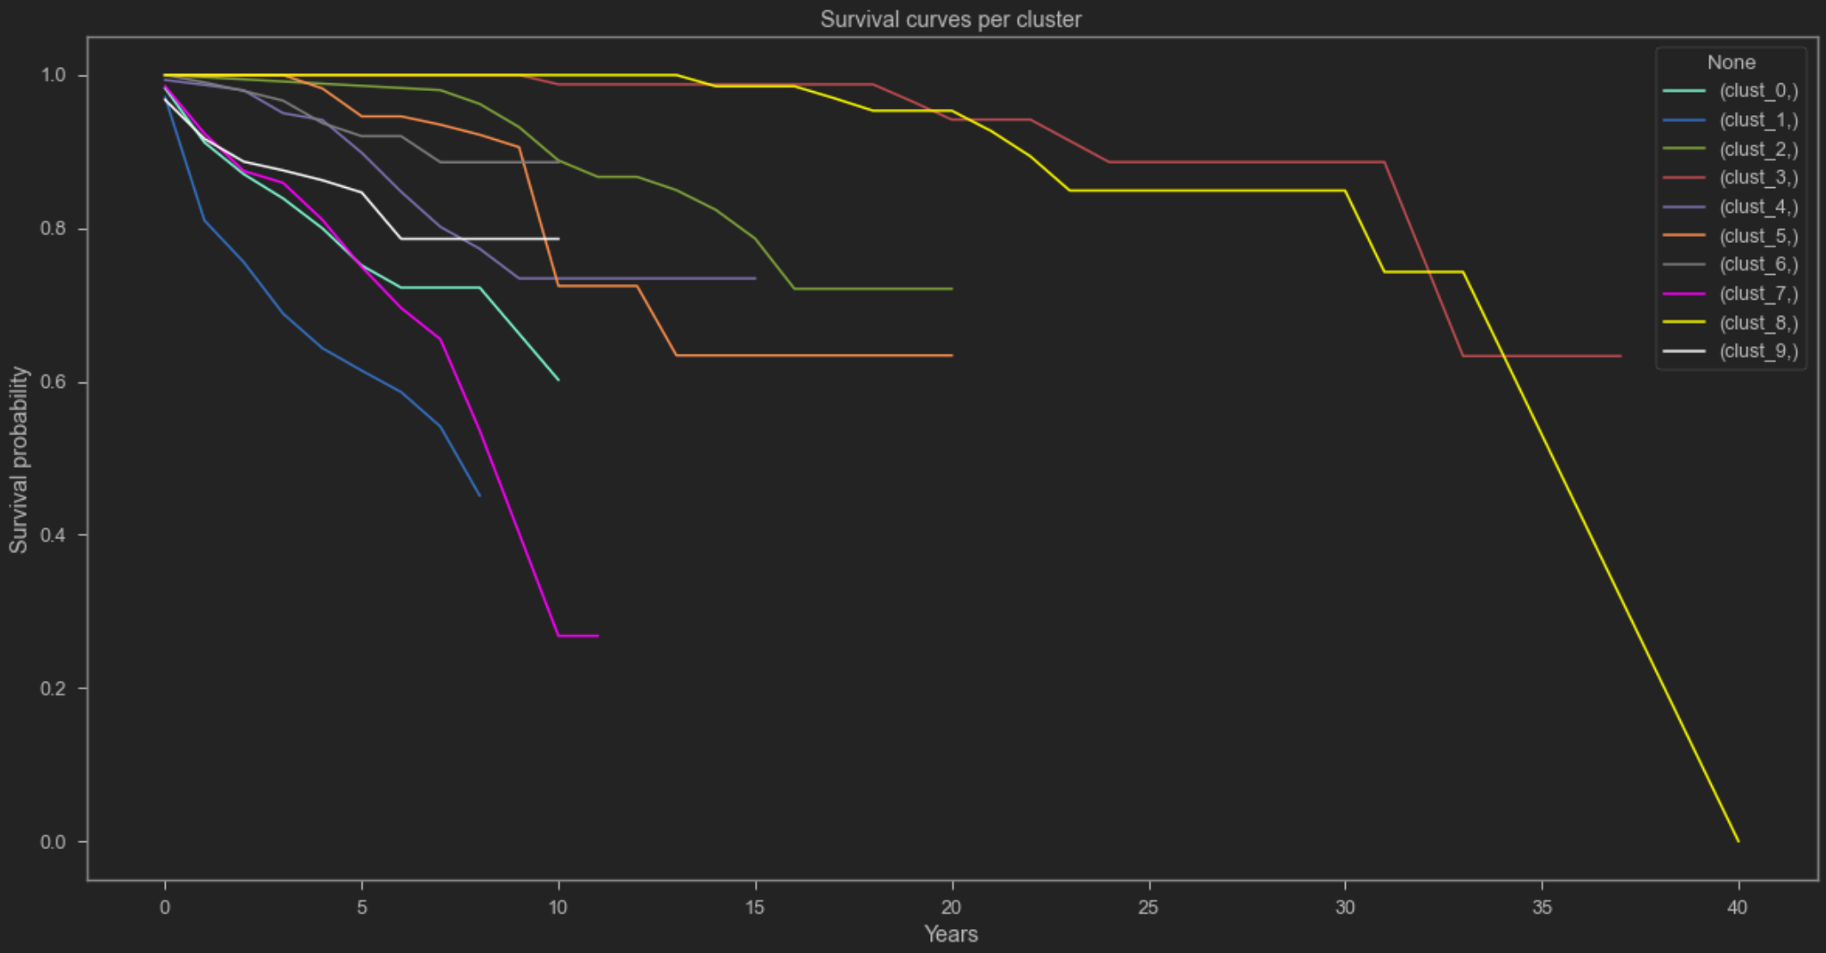
Survival Analysis – Kaplan Meier
We can also use the Kaplan Meier model to predict the probability of survival for each of our 10 clusters.
This timeline will also be represented by years as shown in plot.

Slide 20
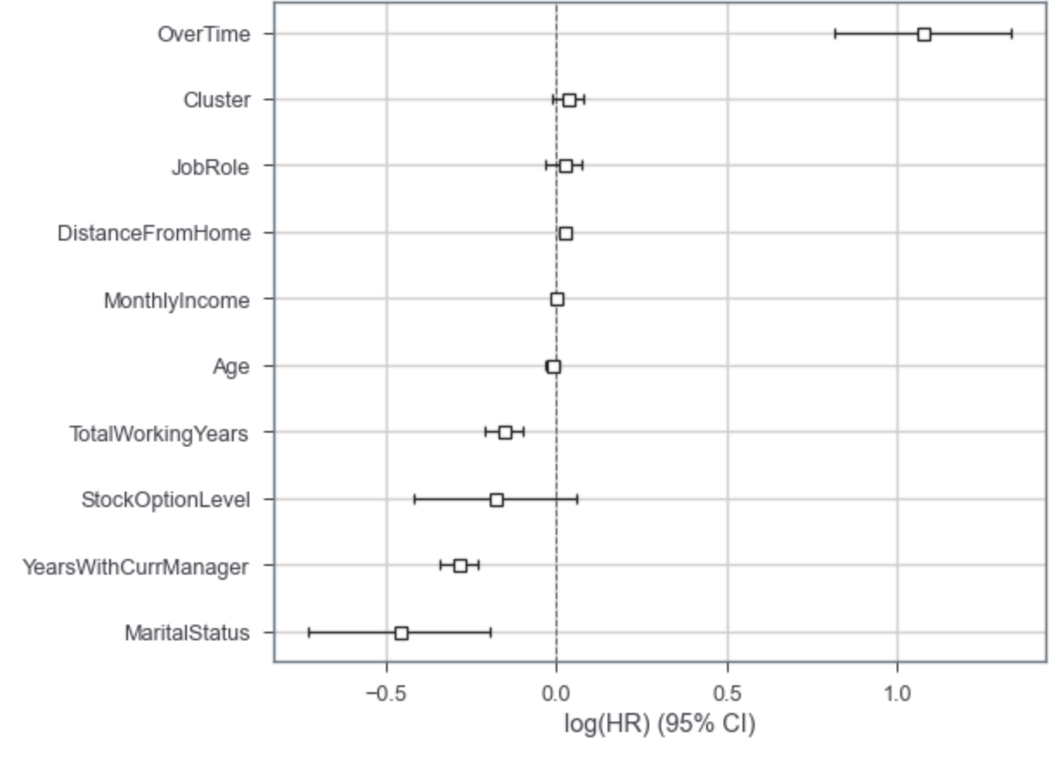
Survival Analysis – Cox Proportional Hazard
Using the Cox Proportional Hazard model, we can plot the features that impact to the hazard rate.
The hazard rate represents the instantaneous rate at which events occur; given that they have not already occurred.

Slide 21
Results
We have segmented the employees in our dataset into clusters.
Then we utilized a Random Forest model to predict whether each employee will experience attrition or not. We were then able to generate a feature importance ranking list.
By segmenting the employees, we were able to predict the survival rates for each of these clusters based on number of years using the Kaplan Meier survival analysis model.
Finally, by using the Cox Proportional Hazard, we were able to plot the feature effects.

Slide 22
Deployment
Our App can be useful for any company that has an active Human Resources division.
They can implement the App to determine the likelihood of employees that will leave due to attrition. This will allow these companies to perform their own survival analysis using their own data.
Companies can also use these models to determine the important factors of attrition. It may also help them to elaborate strategies to retain their top employees.

Slide 23
Thank You

